Slide 1
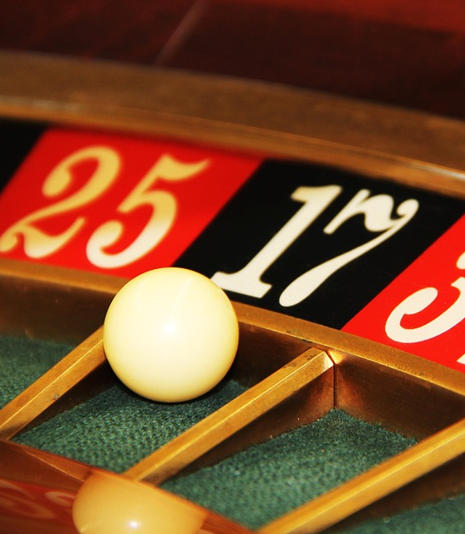
Paper Presentation Luck and the Law: Quantifying Chance in Fantasy Sports and Other Contests
Authors:
Daniel Getty, Masayuki Yano Hao Li, Charles Gao, A. E. Hosoi
Presented by
Avirup Chakraborty

Slide 2

Introduction
Fantasy sports have grown rapidly in recent years. With this growth has come increased regulatory attention, particularly around whether these games are driven more by skill or chance—a key factor in determining their legal classification.
To support this discussion with data-driven insights, the authors have analyzed fantasy sports outcomes and introduce a new metric to objectively quantify the role of skill versus luck across a range of activities.

Slide 3
Data
The dataset used in the study comprises records from FanDuel, a leading provider of daily fantasy sports, covering two full seasons (2013/14 and 2014/15). It includes user performance data from two game formats—Head-to-Head (H2H) and 50/50 competitions—across four major professional sports leagues:
NBA (National Basketball Association)
NFL (National Football League)
MLB (Major League Baseball)
NHL (National Hockey League)
For each game format and league, the dataset captures details such as:
Player lineups, Fantasy scores, Contest outcomes (wins/losses), Entry fees and winnings, User IDs (anonymized).
Preliminary analysis found no significant performance differences between
the H2H and 50/50 formats, allowing the data to be pooled for subsequent statistical analyses unless stated otherwise.

Slide 4
Distinguish Between Game of Chance or Skill
Do players have different expected payoffs when playing the game?
Are player returns correlated over time, implying persistence in skill?
Do actions that a player takes in the game have statistically significant impacts on the payoffs that are achieved?

Slide 5
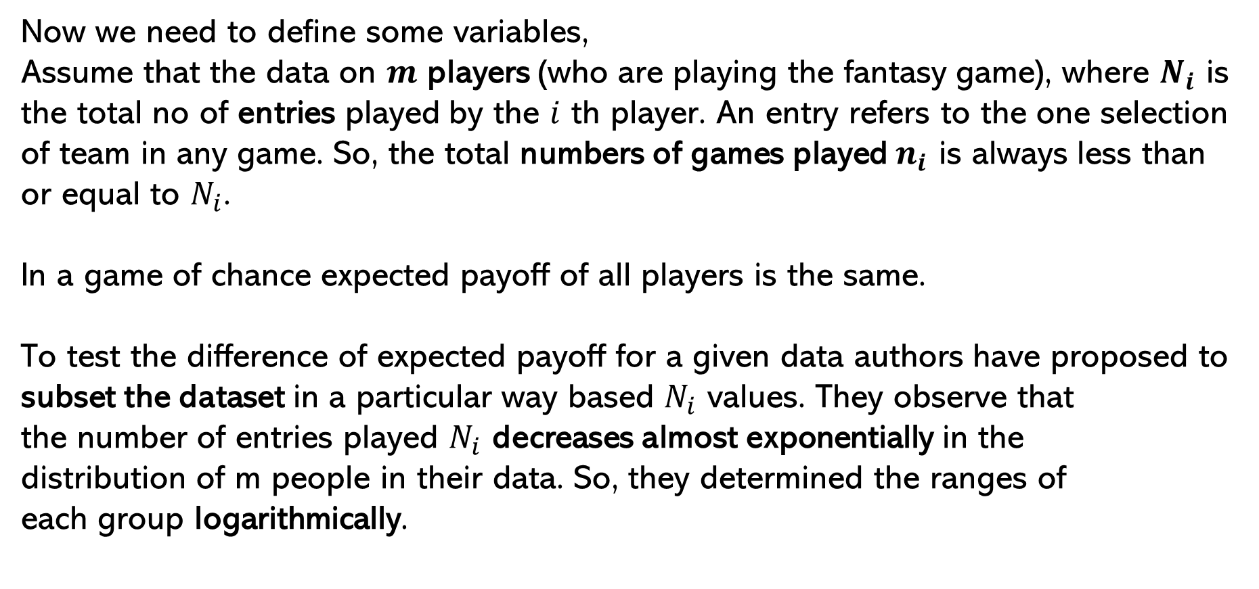
Expected Payoffs
Now we need to define some variables,
Assume that the data on $m$ players (who are playing the fantasy game), where $N_{i}$ is the total no of entries played by the $i$ th player. An entry refers to the one selection of team in any game. So, the total numbers of games played $n_{i}$ is always less than or equal to $N_{i}$.
In a game of chance expected payoff of all players is the same.
To test the difference of expected payoff for a given data authors have proposed to subset the dataset in a particular way based $N_{i}$ values. They observe that
the number of entries played $N_{i}$ decreases almost exponentially in the
distribution of m people in their data. So, they determined the ranges of
each group logarithmically.

Slide 6
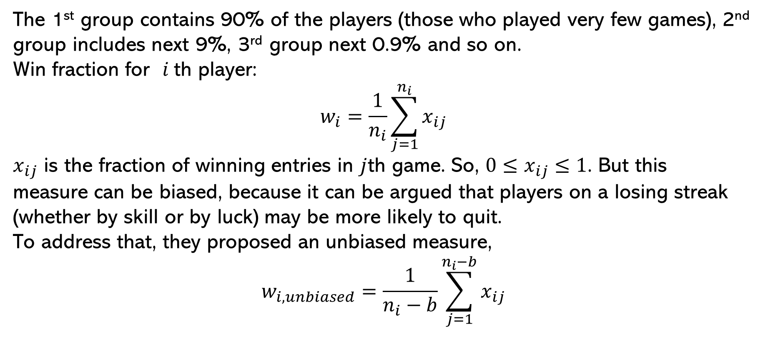
Expected Payoffs
The 1st group contains 90% of the players (those who played very few games), 2nd group includes next 9%, 3rd group next 0.9% and so on.
Win fraction for $i$th player:
$$w_{i}=\frac{1}{n_{i}}\sum_{j=1}^{n_{i}}{x_{ij}}$$
$x_{ij}$ is the fraction of winning entries in $j$th game. So, $0≤x_{ij}≤1$. But this
measure can be biased, because it can be argued that players on a losing streak (whether by skill or by luck) may be more likely to quit.
To address that, they proposed an unbiased measure,
$$w_{i, unbiased}=\frac{1}{n_{i}−b}\sum_{j=1}^{n_{i}−b}{x_{ij}}$$

Slide 7
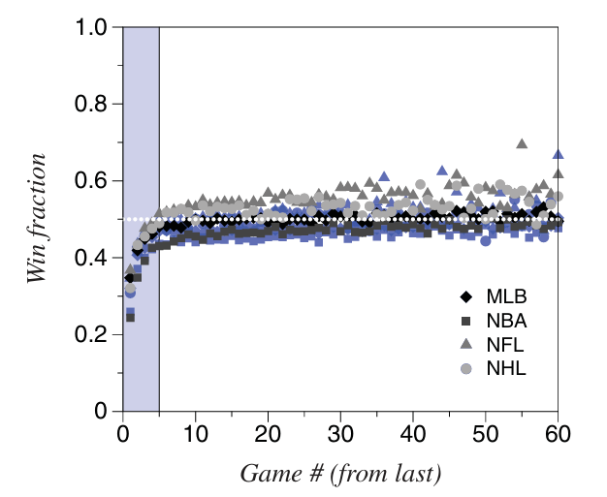
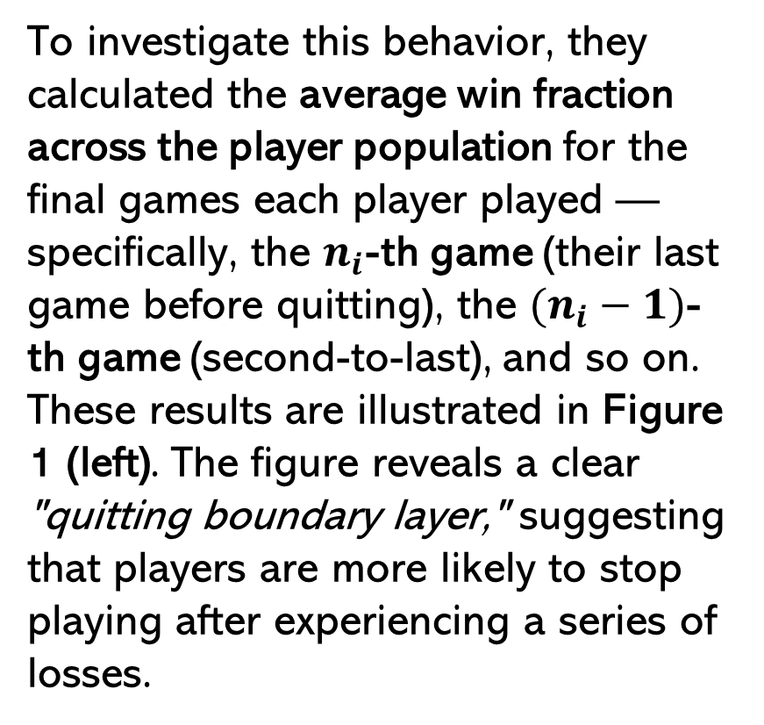
Expected Payoffs
To investigate this behavior, they calculated the average win fraction across the player population for the final games each player played — specifically, the $n_{i}$-th game (their last game before quitting), the $(n_{i}−1)$-th game (second-to-last), and so on. These results are illustrated in Figure 1 (left). The figure reveals a clear "quitting boundary layer," suggesting that players are more likely to stop playing after experiencing a series of losses.
Grey symbols correspond to 50/50 games, blue symbols to H2H games from the 2013/14 season; shapes correspond to different sports as summarized in the legend. The blue shaded region on the left corresponds to the “quitting boundary layer.”

Slide 8
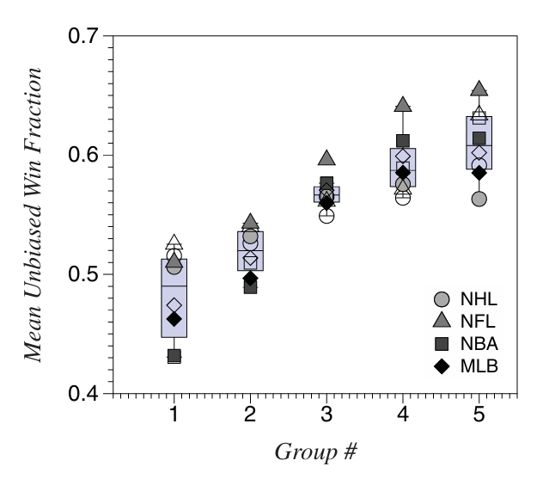
Expected Payoffs
Their data reveal clear trends:
players who play the fewest games have a lower average win fraction of 0.48 (across all four sports), while those who play the most have a significantly higher average of 0.61. This systematic difference suggests that the game outcomes are not driven purely by chance.
Filled symbols correspond the 2014/15 season; empty symbols correspond to the 2013/14 season. Light blue boxes are standard IQR box-and-whisker plots.

Slide 9
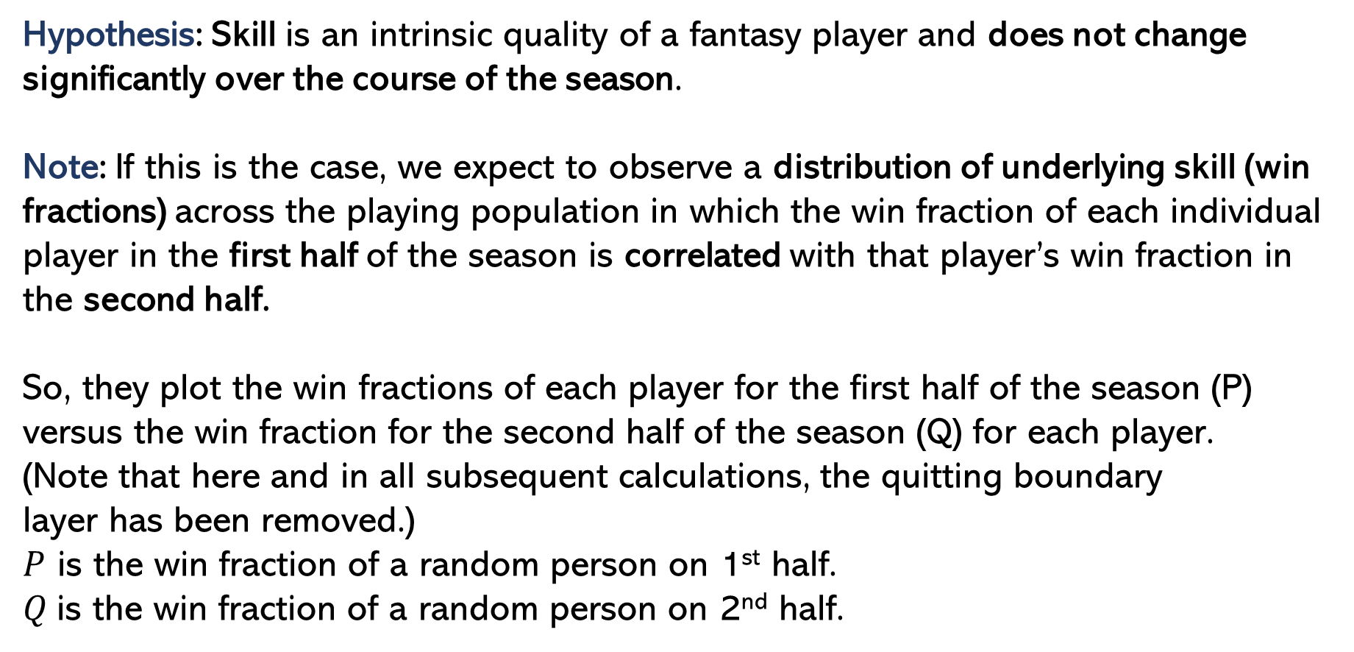
Persistence in Skill
Hypothesis: Skill is an intrinsic quality of a fantasy player and does not change significantly over the course of the season.
Note: If this is the case, we expect to observe a distribution of underlying skill (win fractions) across the playing population in which the win fraction of each individual player in the first half of the season is correlated with that player’s win fraction in the second half.
So, they plot the win fractions of each player for the first half of the season (P) versus the win fraction for the second half of the season (Q) for each player.
(Note that here and in all subsequent calculations, the quitting boundary
layer has been removed.)
$P$ is the win fraction of a random person on 1st half.
$Q$is the win fraction of a random person on 2nd half.

Slide 10
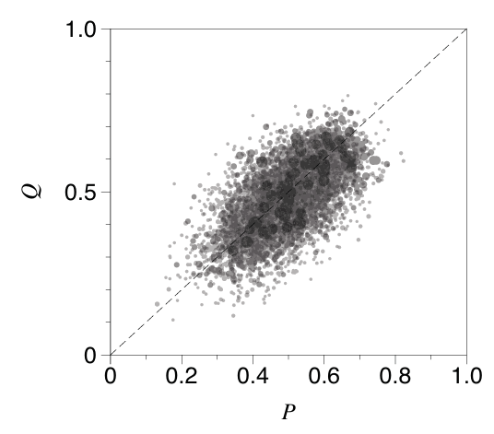
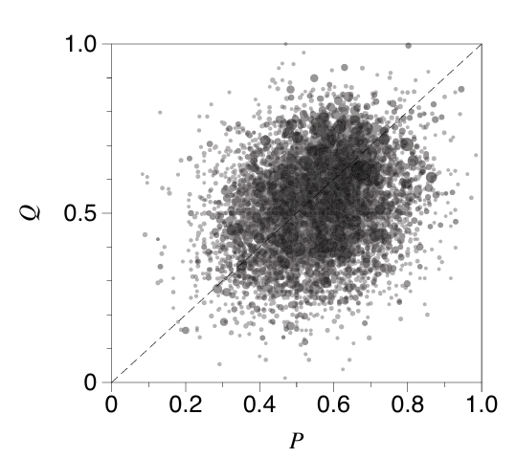
Persistence in Skill
NBA
NFL

Slide 11
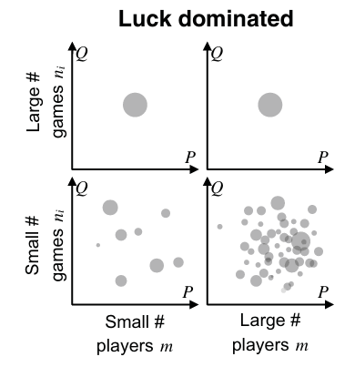
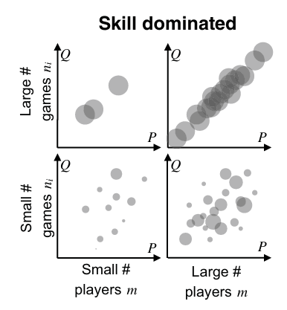
Persistence in Skill
Sketches of expected user win fractions

Slide 12
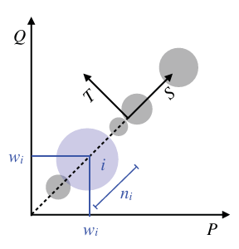
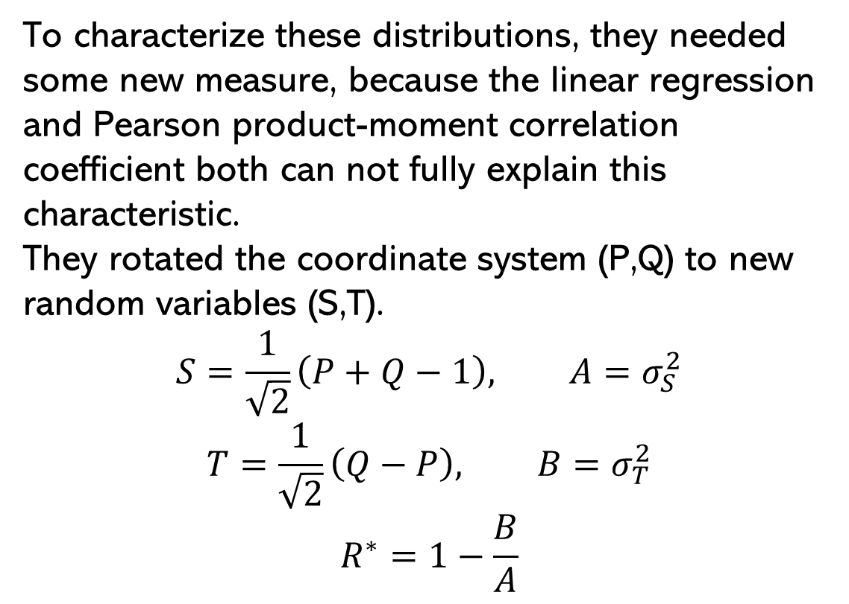
Persistence in Skill
To characterize these distributions, they needed some new measure, because the linear regression and Pearson product-moment correlation coefficient both can not fully explain this characteristic.
They rotated the coordinate system (P,Q) to new random variables (S,T).
$$S=\frac{1}{\sqrt{2}}\left(P+Q−1\right), A=σ_{S}^{2}$$
$$T=\frac{1}{\sqrt{2}}\left(Q−P\right), B=σ_{T}^{2}$$
$$R^{∗}=1−\frac{B}{A}$$

Slide 13
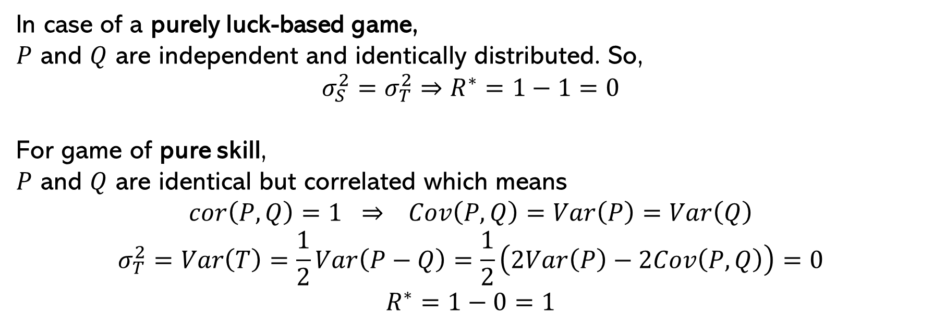
Persistence in Skill
In case of a purely luck-based game,
$P$ and $Q$ are independent and identically distributed. So,
$$σ_{S}^{2}=σ_{T}^{2}⇒R^{∗}=1−1=0$$
For game of pure skill,
$P$ and $Q$ are identical but correlated which means
$$cor\left(P,Q\right)=1 ⇒ Cov\left(P,Q\right)=Var\left(P\right)=Var\left(Q\right)$$
$$σ_{T}^{2}=Var\left(T\right)=\frac{1}{2}Var\left(P−Q\right)=\frac{1}{2}\left(2Var\left(P\right)−2Cov\left(P,Q\right)\right)=0$$
$$R^{∗}=1−0=1$$

Slide 14

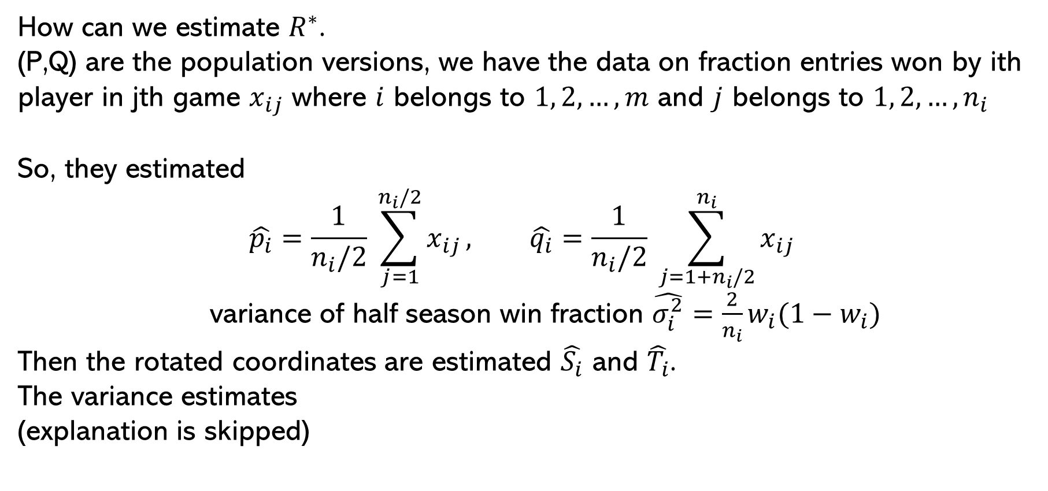
Persistence in Skill
How can we estimate $R^{∗}$.
(P,Q) are the population versions, we have the data on fraction entries won by ith player in jth game $x_{ij}$ where $i$ belongs to $1, 2,…,m$ and $j$ belongs to $1, 2,…, n_{i}$
So, they estimated
$$\hat{p_{i}}=\frac{1}{n_{i}/2} \sum_{j=1}^{n_{i}/2}{x_{ij}}, \hat{q_{i}}=\frac{1}{n_{i}/2} \sum_{j=1+n_{i}/2}^{n_{i}}{x_{ij}}$$
variance of half season win fraction $\hat{σ_{i}^{2}}=\frac{2}{n_{i}}w_{i}(1−w_{i})$
Then the rotated coordinates are estimated $\hat{S_{i}}$ and $\hat{T_{i}}$.
The variance estimates
(explanation is skipped)

Slide 15
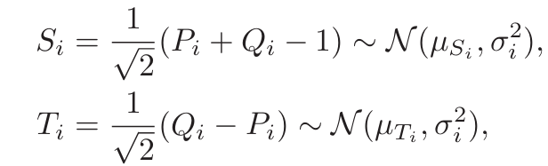
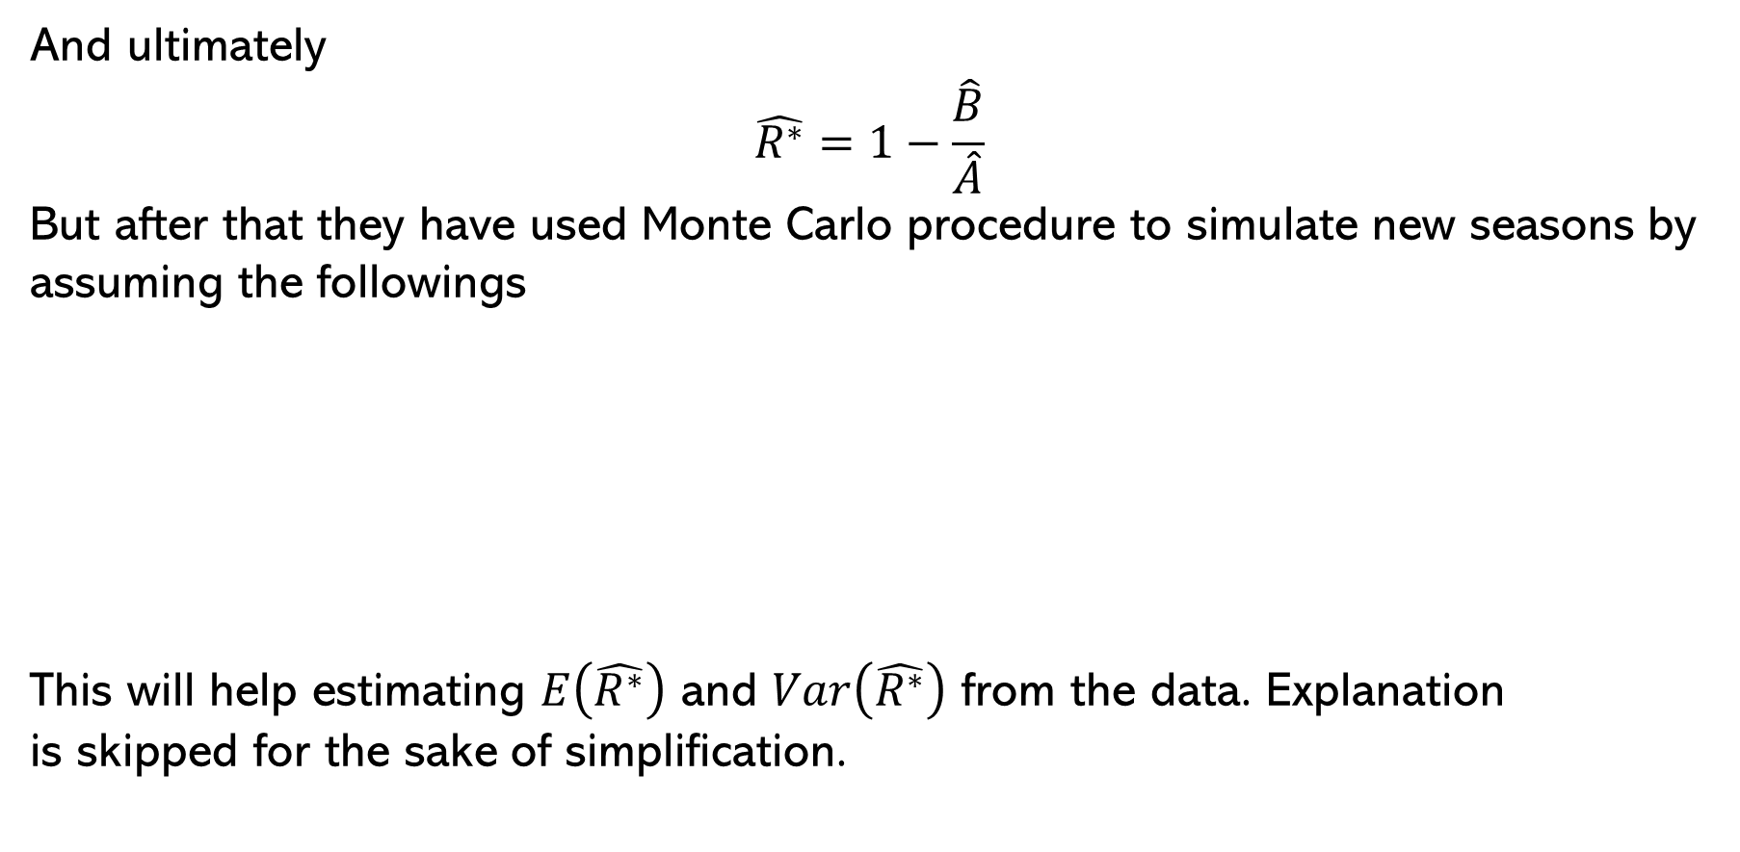
Persistence in Skill
And ultimately
$$\hat{R^{∗}}=1−\frac{\hat{B}}{\hat{A}}$$
But after that they have used Monte Carlo procedure to simulate new seasons by assuming the followings
This will help estimating $E\left(\hat{R^{∗}}\right)$ and $Var\left(\hat{R^{∗}}\right)$ from the data. Explanation
is skipped for the sake of simplification.

Slide 16
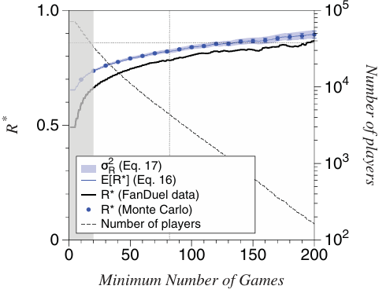
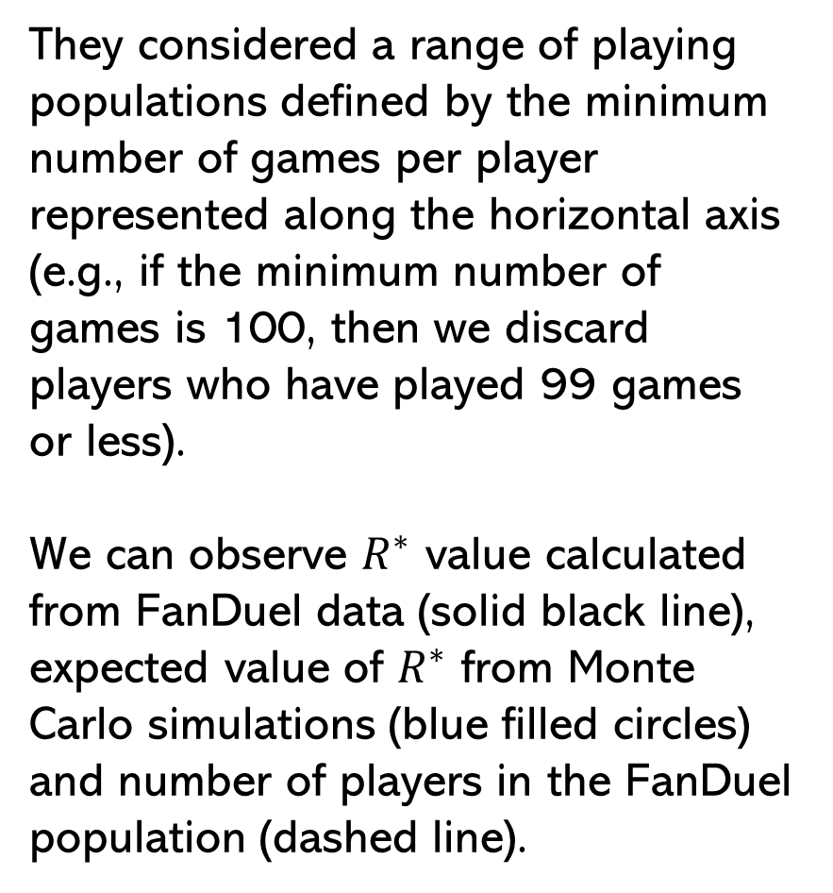
Persistence in Skill
They considered a range of playing populations defined by the minimum number of games per player represented along the horizontal axis (e.g., if the minimum number of games is 100, then we discard players who have played 99 games or less).
We can observe $R^{∗}$ value calculated from FanDuel data (solid black line), expected value of $R^{∗}$ from Monte Carlo simulations (blue filled circles) and number of players in the FanDuel population (dashed line).
Computed error (blue shaded region), vertical dotted line represents the number of games in the corresponding professional sports season and the horizontal dotted line represents the R∗ value calculated for the 2010–2015 seasons corresponding to the relevant professional league.

Slide 17
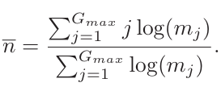

Persistence in Skill
In fantasy sports, the value of $R^{∗}$ depends on the number of games each player has participated in, $n_{i}$. Since the distribution of games played decays exponentially, a simple average is skewed by the many users who played only a few games. To better estimate a representative value, they compute a logarithmically weighted average:
Where, $G_{max}$ is the maximum number of games played
$m_{j}$is the number of players who played $j$ games.

Slide 18
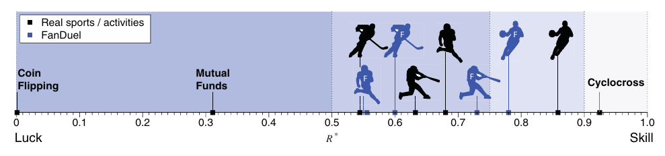
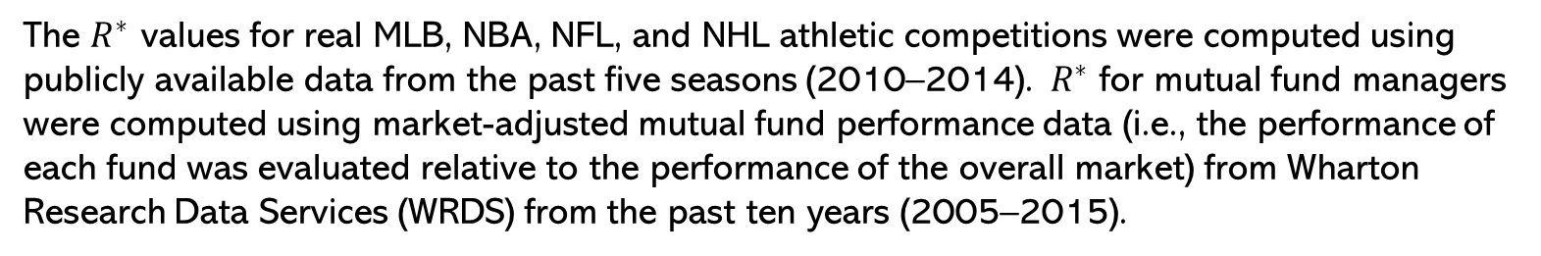
Persistence in Skill
Using real life data as well as with the fantasy game data they calculated the $R^{∗}$ values as following.
The $R^{∗}$ values for real MLB, NBA, NFL, and NHL athletic competitions were computed using publicly available data from the past five seasons (2010–2014). $R^{∗}$ for mutual fund managers were computed using market-adjusted mutual fund performance data (i.e., the performance of each fund was evaluated relative to the performance of the overall market) from Wharton Research Data Services (WRDS) from the past ten years (2005–2015).

Slide 19
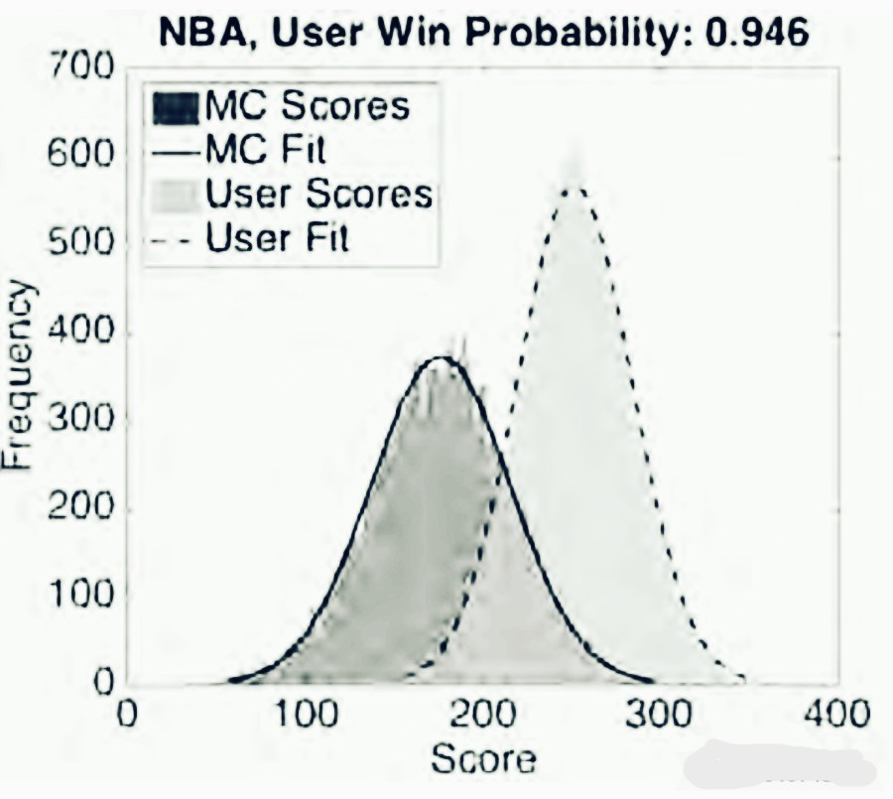
Effect of Player Action
To assess the role of skill in fantasy sports, the score distribution of real players was compared to that of all possible lineups. If skill played no role, both distributions would be similar.
However, generating all possible lineups is computationally infeasible, so a Monte Carlo simulation was used to approximate this distribution. The random lineups were generated using intuitive, salary-cap–based constraints designed to maximize their expected scores.
In the diagram we can see the fantasy players beat the Monte Carlo simulation suggesting that player actions do indeed influence the outcome of the game.

Slide 20
Balance Skill and Chance using Game Design
Effect of Skill Distribution in the Population:
The impact of skill distribution is clear when comparing a professional golfer against a novice versus two evenly matched players (either two professionals or two novices). In the first case, skill dominates, making the outcome nearly certain. In the second, when players are of similar ability, chance plays a larger role in determining the result. Thus, tournaments divided by skill level (e.g., separating beginners from experts) tend to rely more on luck than those where all players compete in the same pool, where skill differences are more decisive.
Increase the games per player:
“Even tiny differences in skill manifest themselves in near certain victory if the time horizon is long enough”. Hence, perhaps the simplest way to increase the role of skill in a contest is to increase the number of games
per player in the competition.

Slide 21
Balance Skill and Chance using Game Design
Changing Game Rules:
Game designers can shift the skill–chance balance by adjusting elements like player pricing. In fantasy sports, perfect pricing removes strategic choices, making outcomes luck-driven. Imperfect pricing, however, allows skilled players to spot undervalued picks. To boost skill, designers can introduce pricing noise or reward high-variance events, making perfect pricing harder.

Slide 22
Conclusions: The metrics proposed by the authors quantifies the balance of skill and chance across activities. Results show that while chance can influence short-term outcomes, skill prevails over repeated play. This has implications for understanding fairness and legality in fantasy sports and beyond.

Slide 23
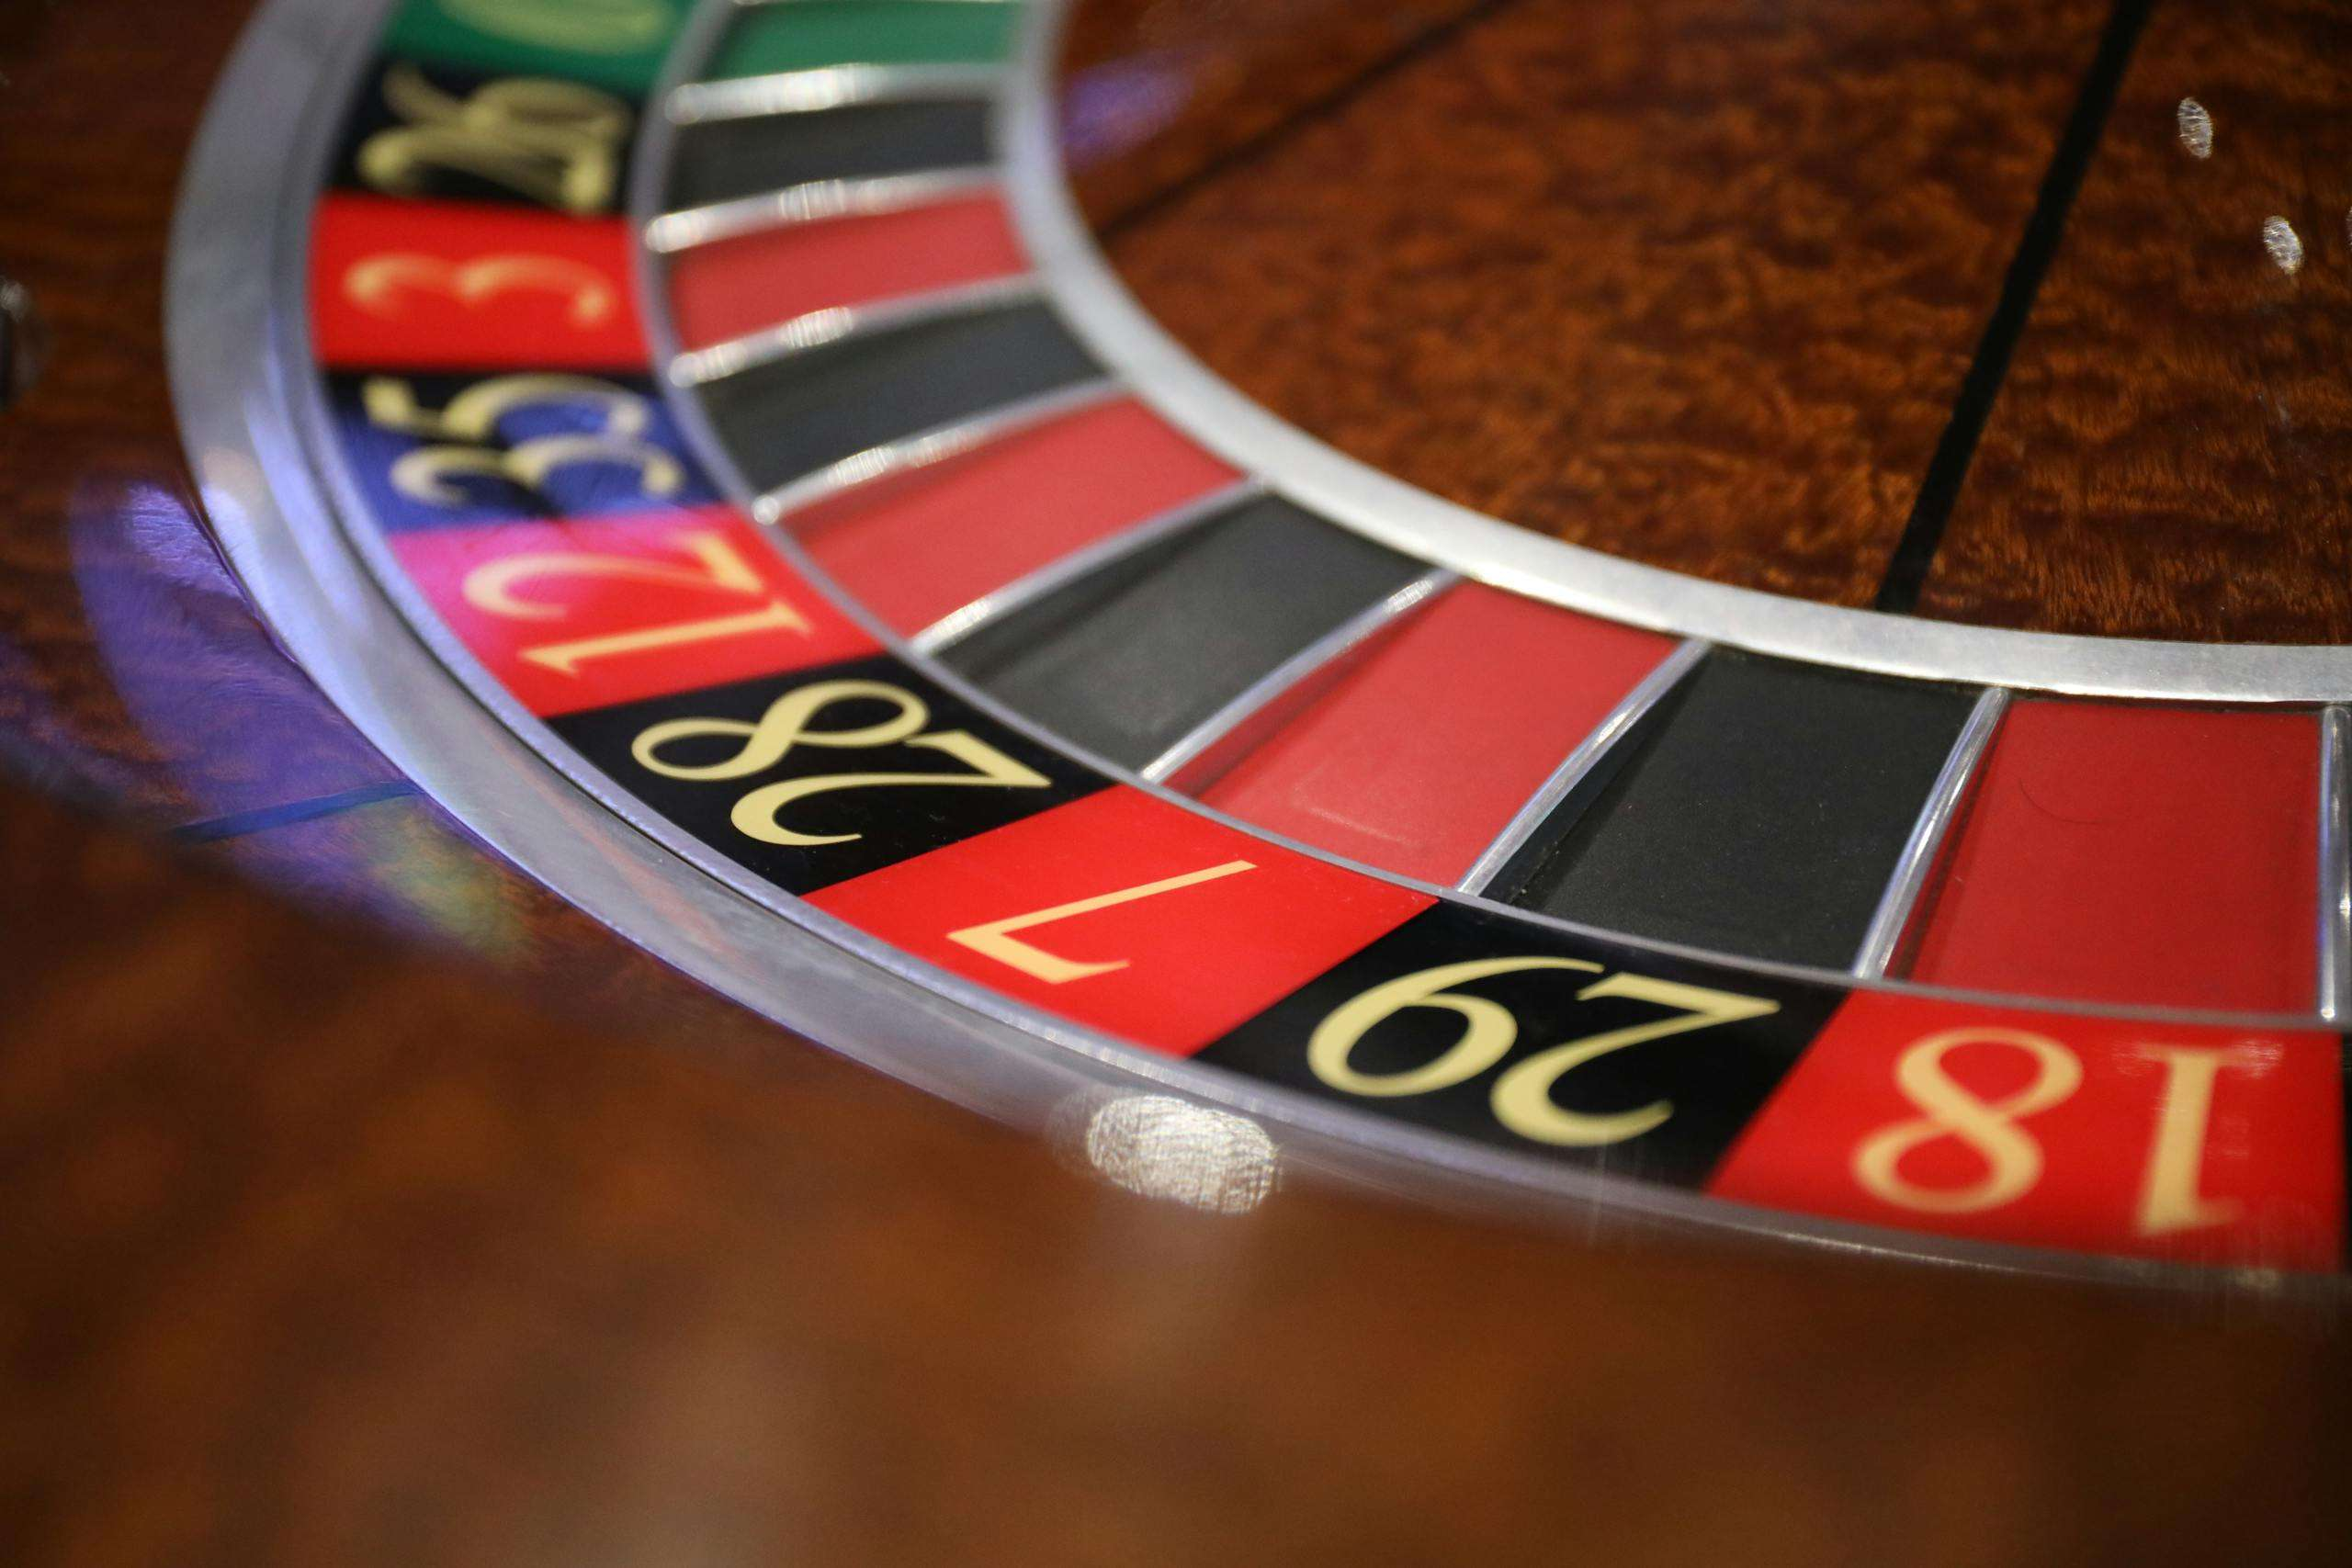



Thank you

